Slide 1
Highlights of 2021 Solid Minerals Industry Report
@NigeriaEITI
www.neiti.gov.ng

Slide 2
Focus of the Audit
Theme
Impact built on blocking leakages to grow revenue
12th Cycle of SM Report by NEITI
@NigeriaEITI
www.neiti.gov.ng

Slide 3
Companies & Key Government Agencies Covered by the Report
1,214
3
Extractive Companies
Government Entities
A total of 914 companies made payment of royalty out of which 121 met the materiality threshold and were responsible for 92% total royalty payment for the year.
@NigeriaEITI
www.neiti.gov.ng

Slide 4
Key Highlights of the Report
Total revenue generated by the sector in the year under review
N193.59 billion
Total revenue generated by government from the sector in 2021
2021: Increase of ₦60.32 billion or 51.89%
2020: ₦116.82 billion
N177.44 billion
Financial flows to the Federation Account
@NigeriaEITI
www.neiti.gov.ng

Slide 5
Key Highlights of the Report
Breakdown of the Revenues as generated by the agencies
FIRS | N169.52 Billion
Mining Cadastre Office | N4.3 Billion
Mining Inspectorate Department | N3.62 Billion
N1.06 Billion Company Outstanding financial liabilities to government-failure of some of the companies to pay their annual service fees for the respective mineral titles.
@NigeriaEITI
www.neiti.gov.ng

Slide 6
Key Highlights of the Report
Trend of Sector Contribution to FGN Receipts
The sector has contributed ₦818.04billion (USD3.2billion) to Federal Government’s receipts between 2007 and 2021
S/N | Year | No. of Companies | FGN Receipts billion ₦
1 | 2007 | 78 | 7.59
2 | 2008 | 78 | 10.57
3 | 2009 | 78 | 19.15
4 | 2010 | 78 | 17.1
5 | 2011 | 67 | 27.01
6 | 2012 | 65 | 25.57
7 | 2013 | 65 | 30.25
8 | 2014 | 39 | 49.17
9 | 2015 | 42 | 64.46
10 | 2016 | 56 | 43.22
11 | 2017 | 59 | 52.76
12 | 2018 | 69 | 69.47
13 | 2019 | 74 | 79.96
14 | 2020 | 102 | 128.17
15 | 2021 | 121 | 193.59
Total |  |  | 818.04
@NigeriaEITI
www.neiti.gov.ng

Slide 11
2020-2021 Year-On-Year Market Growth
The details of licenses issued for the year 2020 - 2021
2020
2021
Exploration License (EL)
516
840
Increase of 85% in number of artisanal minerals operators to 2,336 across the country
No commensurate data in production, royalty payments, exports, etc. to support this increase in operators.
Mining Lease (ML)
12
40
Quarry Lease (QL)
185
255
598
771
Small Scale Mining Lease (SSML)
Reconnaissance Permit (RP)
171
139
Total
1,482
2,045
@NigeriaEITI
www.neiti.gov.ng

Slide 13
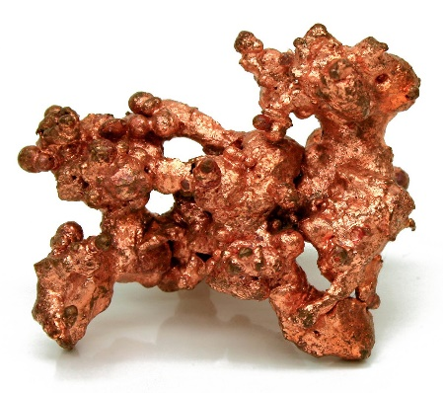
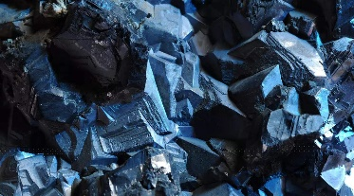
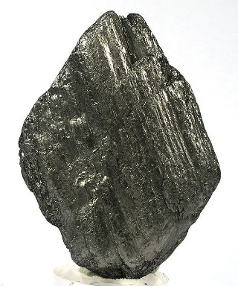
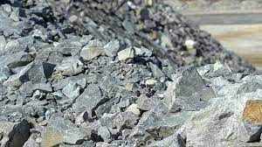
NEITI Solid Minerals Report & Nigeria’s Energy Transition Plan
Energy Transition Minerals or the future minerals as listed below.
Cobalt
Lithium
Nickel
Copper
Graphite
Titanium
20 exploration licenses for Lithium
30 exploration licenses for Copper respectively issued in 2021.
Copper
cobalt
Graphite
Lithium
@NigeriaEITI
www.neiti.gov.ng

Slide 14
Public Disclosure on Solid Minerals Contracts & Beneficial Ownership
Contracts
Beneficial Ownership
Contracts
Beneficial owners of companies are natural persons who directly or indirectly own or control a corporate entity.
Section 116(1) of the Nigerian Minerals and Mining Act (NMMA) 2007 provides a community Development Agreement (CDA) is signed between company and the host community.
67 CDAs out of 121 companies covered in the report were obtained and documented.
NEITI website has additional information on CDAs collected during the reconciliation process.
The beneficial ownership data are publicly accessible either through the NEITI or the CAC Portal.
107
BO information were obtained
out of121companies covered in the audit.
@NigeriaEITI
www.neiti.gov.ng

Slide 15
Nigeria’s Solid Minerals Exports & Destinations
The total minerals exported
Export by Destination
China accounted for 95% and 88% of the total export volume and value respectively
143,000 tons.
But First patriots contributed the highest value- $44.83 Million.
Export by Mineral Type
Lead ores and concentrates was the highest mineral exported, accounting for 7.7% of the total export and 35.3% FOB value.
Export Destination by Value
China 87.89%
Malaysia 4.64%
Korea 1.41%
Thailand 1.17%
UAE 1.11%
Export Volume by Company
Sino Min-metals Co. Limited 44.07%
Synee Alumony Mining Limited 7.19%
First Patriot Ltd 3.63%
Others 45.11%
@NigeriaEITI
www.neiti.gov.ng

Slide 16
Contribution of the Sector to the Economy
0.63%
Contribution to GDP
0.24%
Contribution to Export
Nigeria’s GDP in 2021 was N173.53 trillion. Contribution of the Solid minerals sector
N1.10 trillion
The value of Nigeria’s export in 2021 was N18,200 billion. Solid minerals sector contribution was
N43.68 billion
2.62%
Contribution to government revenue
The federal government revenue collection N6.63 trillion.
Solid minerals sector contribution -
N173.98 billion
@NigeriaEITI
www.neiti.gov.ng

Slide 17
Key Findings and Recommendations
The report made a total of 44 findings & recommendations from Page 76 -94 of the report covering the following areas:
Regulation issues
Financial Issues
Environmental Issues
Process Issues
Production
Volume management
Revenue Generation
Global emerging development issues in the Solid Minerals sector
@NigeriaEITI
www.neiti.gov.ng

Slide 18
Key Findings and Recommendations
 | Findings | Recommendation
1 | The total revenue from the sector over the last fifteen years (2007 – 2021) was 814.59bn. This amount is significantly low compared to the economic potential of the sector. | The FGN through the MMSD should establish a Special Purpose Vehicle (SPV) dedicated to de-risking the solid minerals sector value chain. Furthermore, the MMSD and MCO should constantly engage with the relevant stakeholders to sustain conducive environment for investments and revenue growth in the sector.
@NigeriaEITI
www.neiti.gov.ng

Slide 19
Key Findings and Recommendations
 | Findings | Recommendation
4 | The report noted a significant variance of 38,145.85 tons between solid minerals export data reported by NCS and MMSD-MID. This variance is as a result of non-collaboration between the NCS and MMSD. | MMSD-MID’s collaboration with the NCS on the issue of export permit. The NCS should enforce compliance on export permits from MID prior to mineral export.
5 | This report has found that the signed CDAs in the custody of the MMSD(MECD) are not publicly accessible. | Host all signed CDAs on MMSD website to make them easily accessible to the public.
@NigeriaEITI
www.neiti.gov.ng

Slide 20
Key Findings and Recommendations
 | Findings | Recommendation
6 | This report noted an emerging phase in the mining sector - Nigeria Energy Transition Plan, which seeks to create significant investment opportunities for the establishment and expansion of industries related to solar energy, hydrogen, and electric vehicles. | The FGN should collaborate with relevant stakeholders to ensure that the Energy Transition Plan (ETP) is consciously implemented.
@NigeriaEITI
www.neiti.gov.ng

Slide 21
Key Findings and Recommendations
 | Findings | Recommendation
7 | Only 39 out of 121 companies made the mandatory social payments as contained in the CDA signed with their host communities while 10 companies made only non -mandatory social payments/expenditures. This reveals poor compliance to the social benefit to host communities’ requirements of the NMMA 2007 and NMMR 2011 as embedded in the CDA’s. | The MMSD and MCO should collaborate on a framework for monitoring compliance with the terms of MMA 2007 and MMR 2011 and impose appropriate penalties on defaulters.
@NigeriaEITI
www.neiti.gov.ng

Slide 22
Thank you
@NigeriaEITI
www.neiti.gov.ng

